Slide 1
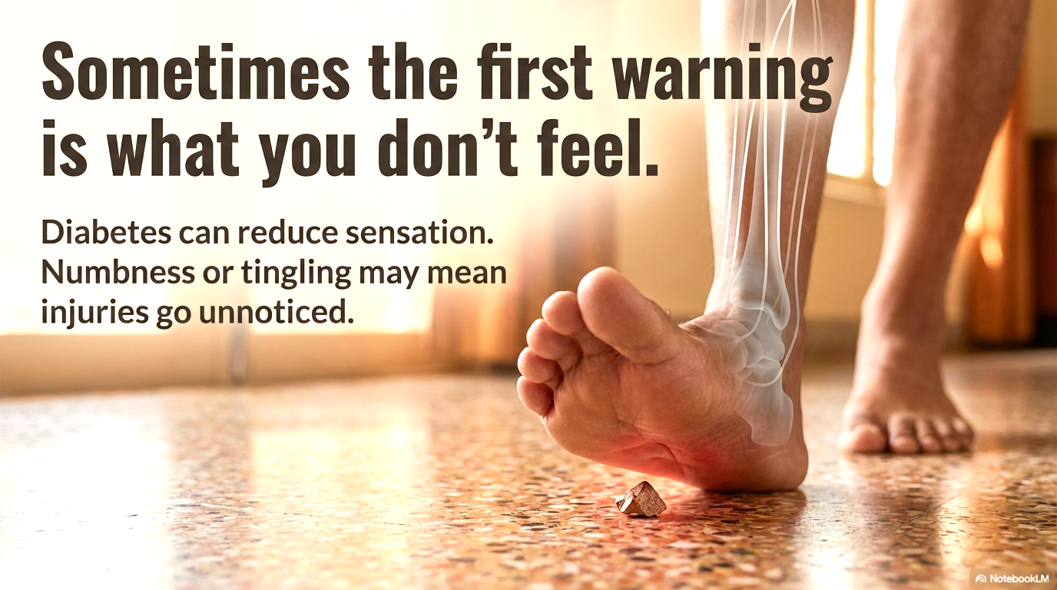
Dr Sangeeta Dhanuka

Slide 2
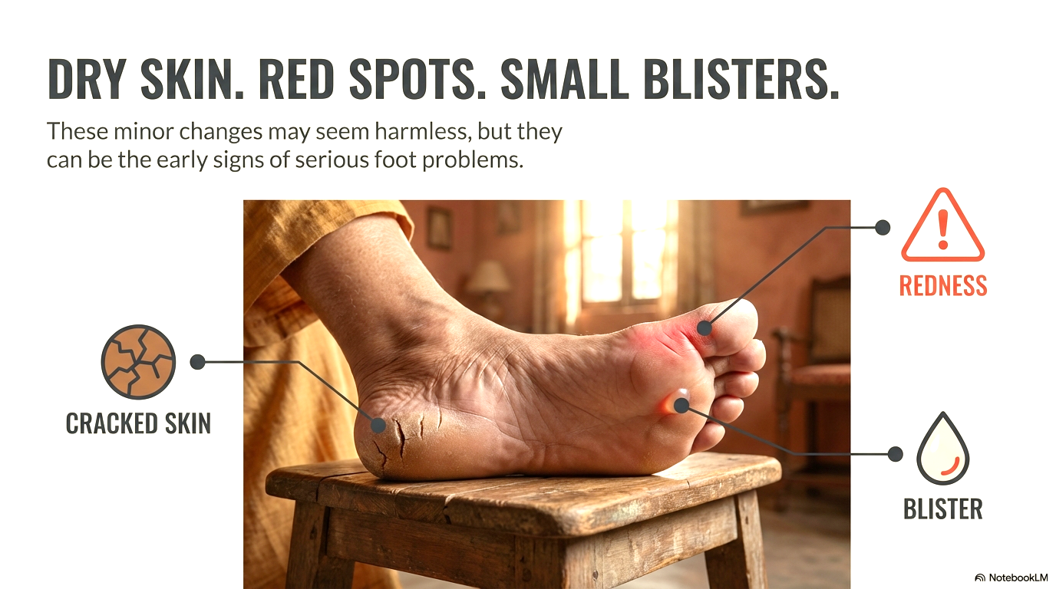
Dr Sangeeta Dhanuka

Slide 3
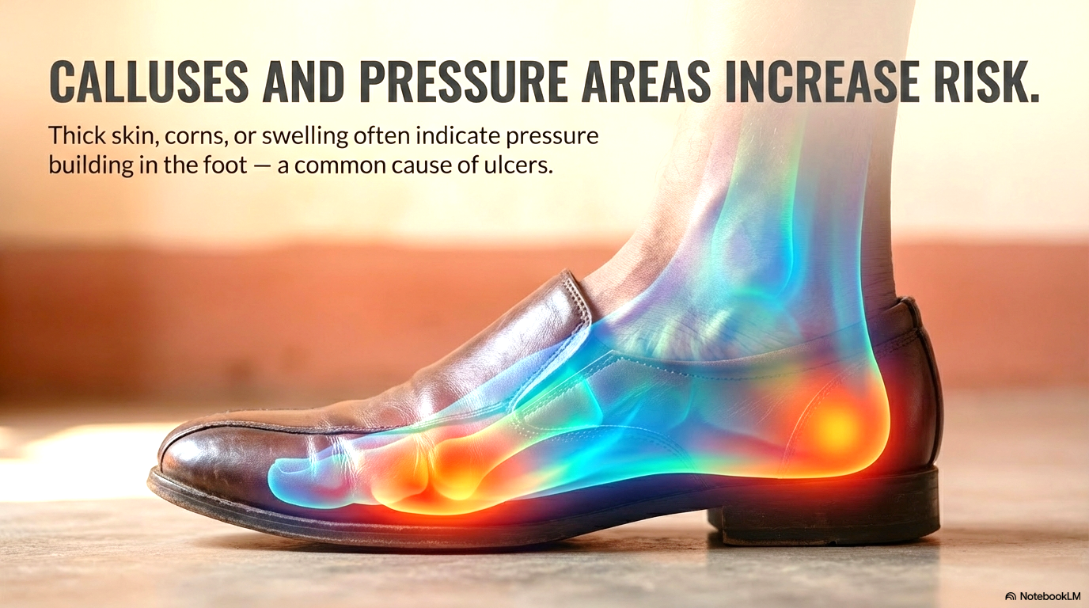
Dr Sangeeta Dhanuka

Slide 4
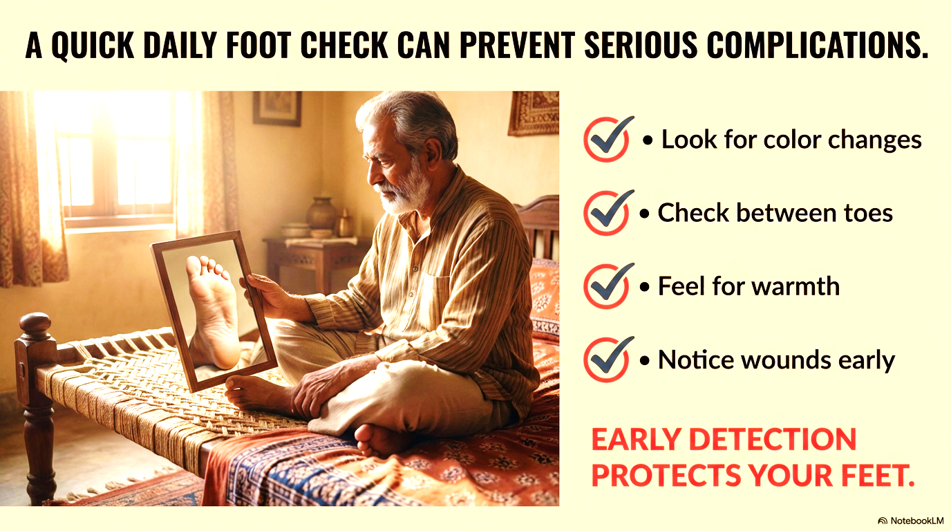
IF YOU HAVE DIABETES, A QUICK DAILY FOOT CHECK CAN PREVENT SERIOUS COMPLICATIONS. IF YOU NOTICE CHANGES, CONSULT YOUR DOCTOR EARLY
Dr Sangeeta Dhanuka

